Slide 1
Rails Marketplace
Application
By Nick Fletcher

Slide 2
Description
My marketplace application was made with the intent to be able to allow customers who like to ride motorbikes to come in, view and then buy a particular part or piece of gear for their motorbikes. They can also buy pieces of gear to wear for when they ride their motorbikes.

Slide 3
Target Audience
The target audience for my marketplace application are people who:
Like to ride motorbikes
Like to customise their bike
Run a motorbike repair shop
Need to replace a part on their motorbike
People looking to buy gear to ride their bikes

Slide 4
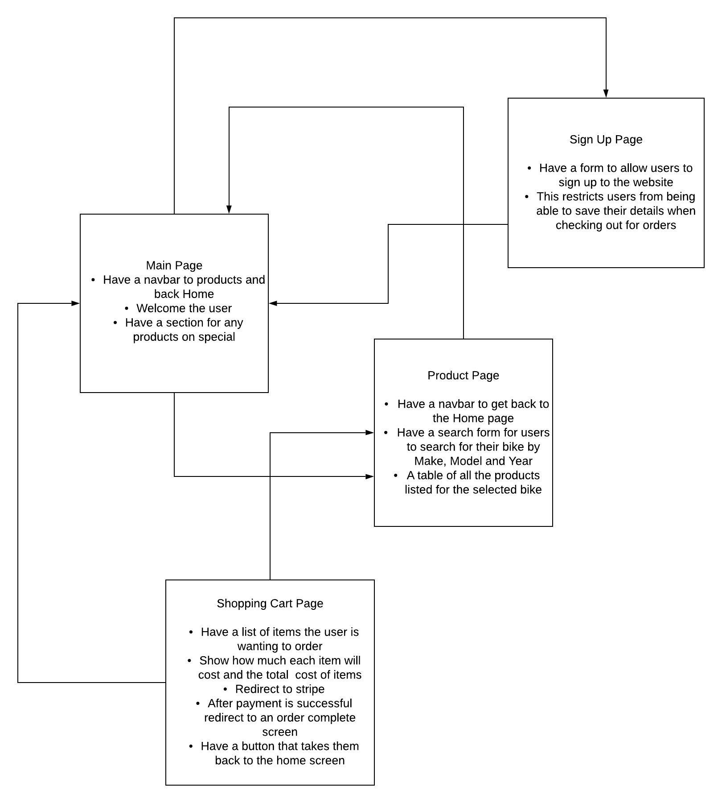
Rails App ERD

Slide 5
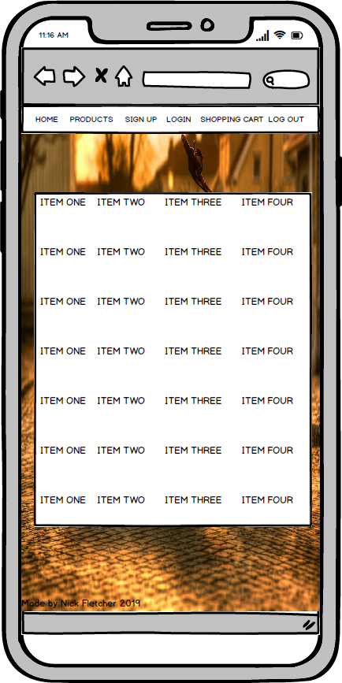
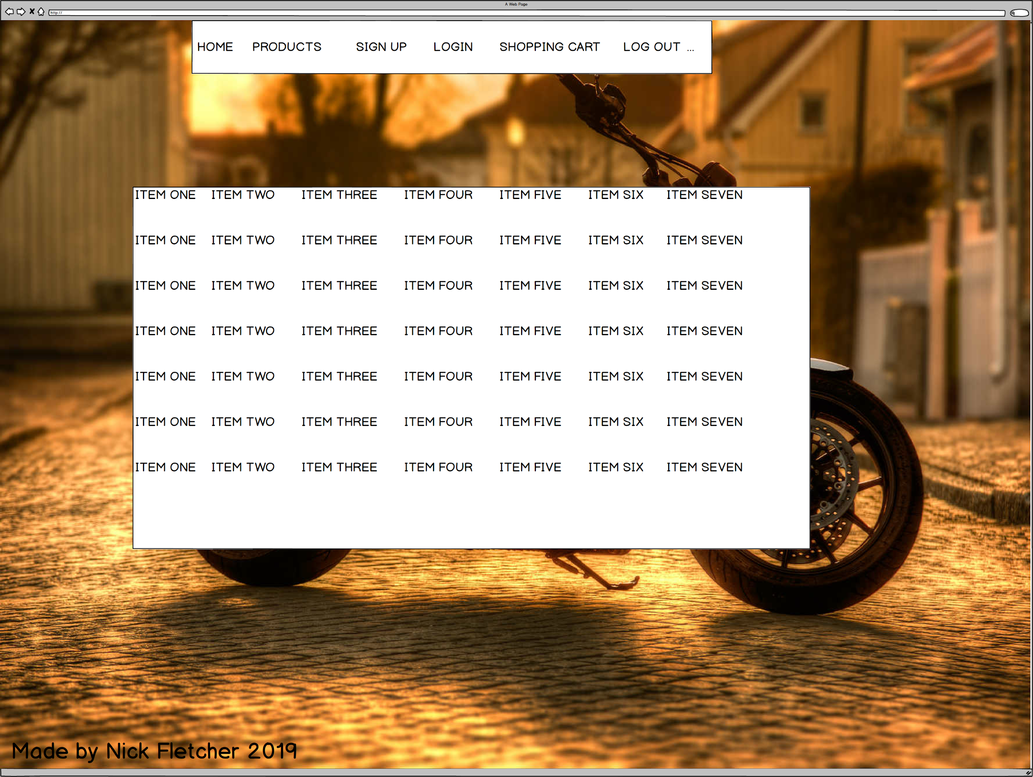
Rails App Mockups

